Slide 1


‘‘‘ Python II – Group 3 Wikipedia Page Visits Timeseries Analysis ’’’
group3 = [
(Alberto_Donà),
(Rupam_Sawant),
(Amine_Bakkoury),
(Lucie_Fourcault),
(Sarra_Cherif),
(Mario_Garcia)
]

Slide 2

agenda = { }
(1: context_on_the_data),
(2: pre_processing),
(3: SQL_database),
(4: project_structure),
(5: feature_engineering_data_viz),
(6: feature_engineering_timeseries),
(7: random_forest)
group_3

Slide 3
agenda = { }
(1: context_on_the_data),
(2: pre_processing),
(3: SQL_database),
(4: project_structure),
(5: feature_engineering_data_viz),
(6: feature_engineering_timeseries),
(7: random_forest)
group_3

Slide 4

context_on_the_data
the dataset consists of approximately 145k time series. Each of these time series represent a number of daily views of a different Wikipedia article, starting from July, 1st, 2015 up until December 31st, 2016
The data we used is:
train_1 🡪 contains traffic data. This a csv file where each row corresponds to a particular article and each column correspond to a particular date.
group_3

Slide 5
agenda = { }
(1: context_on_the_data),
(2: pre_processing),
(3: SQL_database),
(4: project_structure),
(5: feature_engineering_data_viz),
(6: feature_engineering_timeseries),
(7: random_forest)
group_3

Slide 6

pre-processing
The dataset showed an elevated number of columns 551, that are named accordingly to different dates (dd-mm-yyyy), making it hard to name SQL table columns accordingly.
We used the code pandas.melt() with which we created 3 columns: [Page (already existing), Date, Visits]
This resulted in the creation of a Dataframe composed by 3 columns and approximately 79M rows ..
group_3

Slide 7
agenda = { }
(1: context_on_the_data),
(2: pre_processing),
(3: SQL_database),
(4: project_structure),
(5: feature_engineering_data_viz),
(6: feature_engineering_timeseries),
(7: random_forest)
group_3

Slide 8


SQL_database
After cleaning the data we loaded it in a first SQLite database (sqlite3:///wikipedia.db). This happened to be too heavy to be pushed through git (7gb) so ..
We filtered the data with a SELECT statement that brought us the top 100 pages per page visits and uploaded into a secon SQLite database (sqlite3:///wikitop100.db).
This allowed us to shrink the number of rows by a great quantity but still conducting a timeseries analysis more specific to the top 100 pages per visit,
Wikipedia_complete.db
wikipedia.db
group_3

Slide 9
agenda = { }
(1: context_on_the_data),
(2: project_structure),
(3: pre_processing),
(4: project_structure),
(5: feature_engineering_data_viz),
(6: feature_engineering_timeseries),
(7: random_forest)
group_3

Slide 10






project_structure
b
.kaggle
src
kaggle.json
analytics
wikipedia
cleaning
data_extraction
data
sqllite
raw
data.csv
visualisation
std
main.py
data.csv
ux.py
database
wikipedia._complete
notebooks
group_3

Slide 11
agenda = { }
(1: context_on_the_data),
(2: pre_processing),
(3: SQL_database),
(4: project_structure),
(5: feature_engineering_data_viz),
(6: feature_engineering_timeseries),
(7: random_forest)
group_3

Slide 12

feature_engineering
For the plots of the data we focused on some main aspects:
Generally statistics regarding the views per day (mean, median)
We compared the amount of accesses from the mobile and desktop and put them in a timeseries as well
Ranked the languages with the most page views
Analyzed the top pages and for the top page per views we plotted a timeseries
group_3

Slide 13
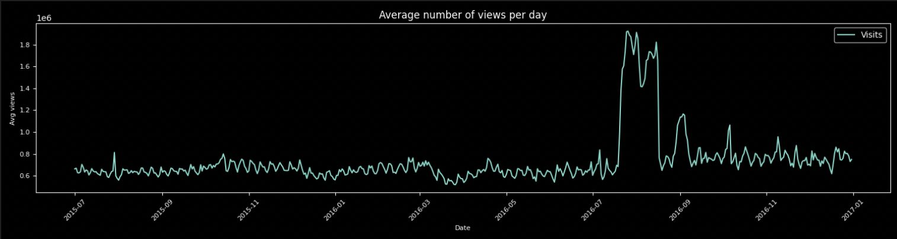
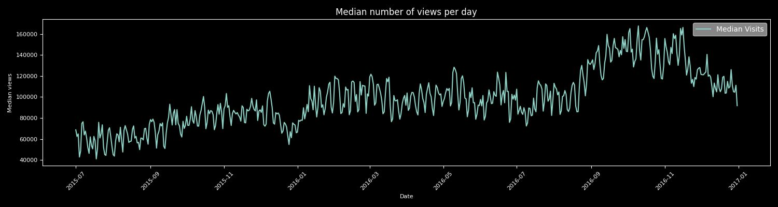
feature_engineering_data_viz
Average Number of Views per Day
Median Number of Views per Day
group_3

Slide 14
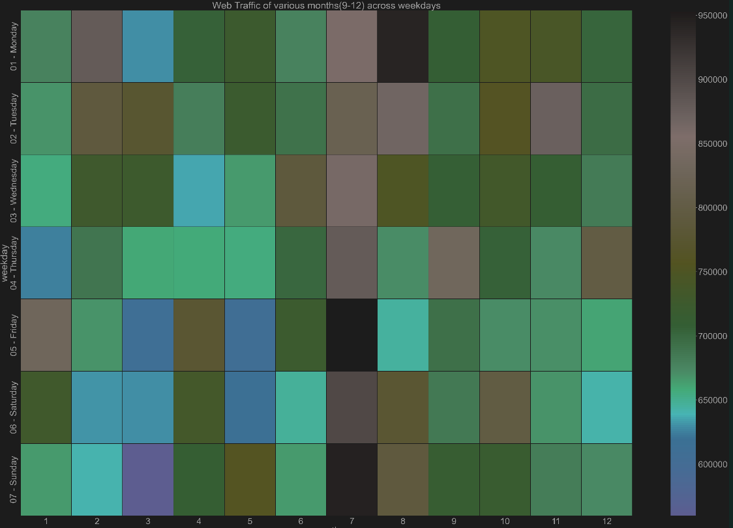
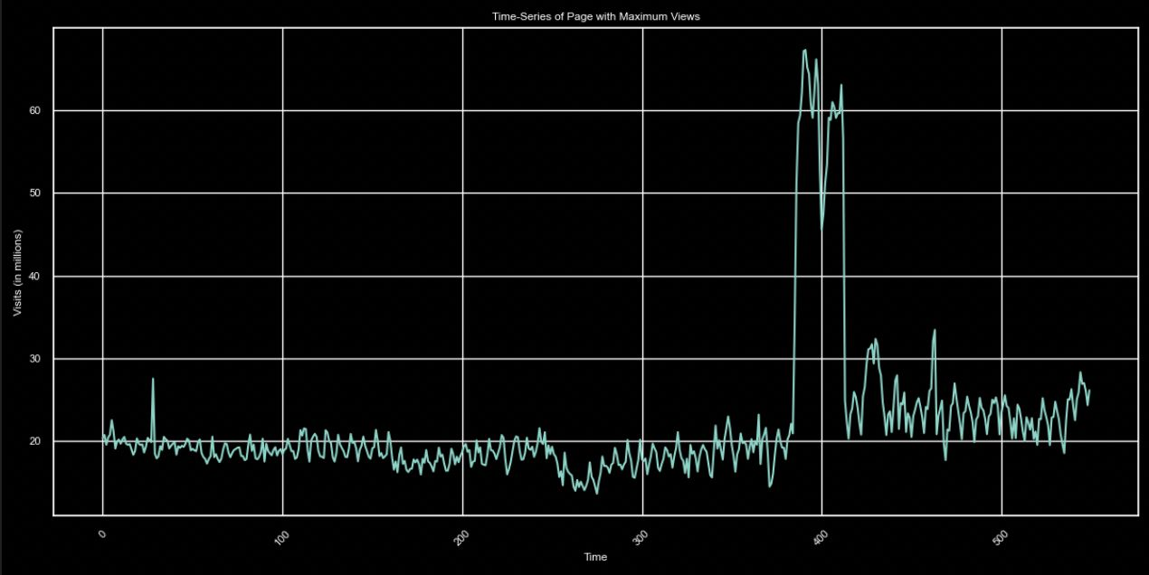
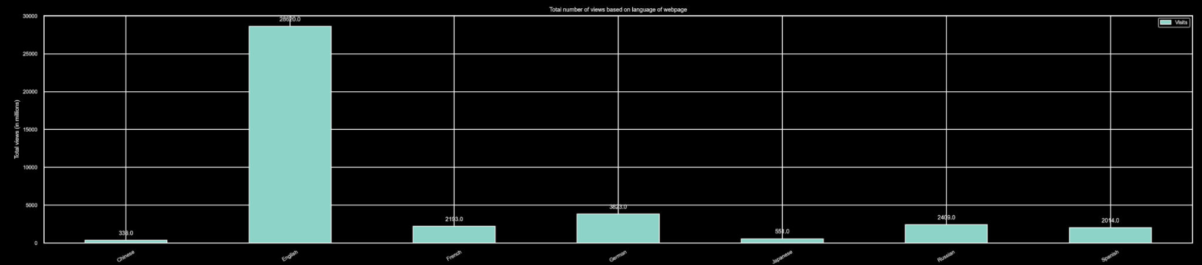
Time-Series with Maximum Views
Web Traffic of Various Months across Weekdays
Total Number of Views based on Language of Webpage
group_3

Slide 15
agenda = { }
(1: context_on_the_data),
(2: pre_processing),
(3: SQL_database),
(4: project_structure),
(5: feature_engineering_data_viz),
(6: feature_engineering_timeseries),
(7: random_forest)
group_3

Slide 16
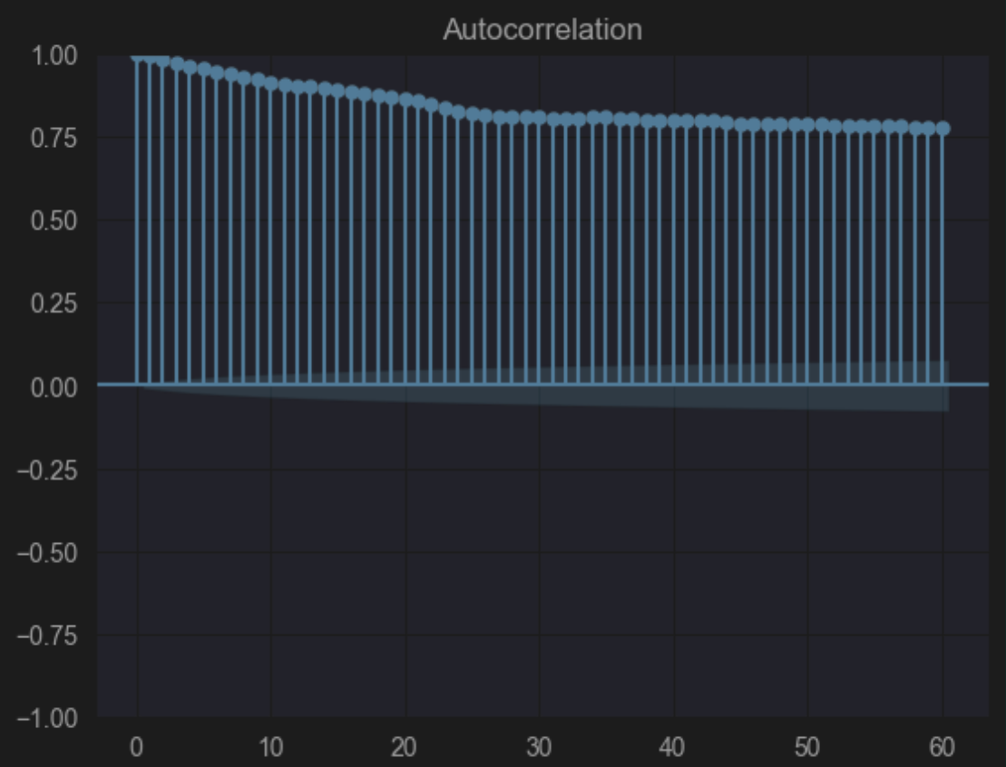
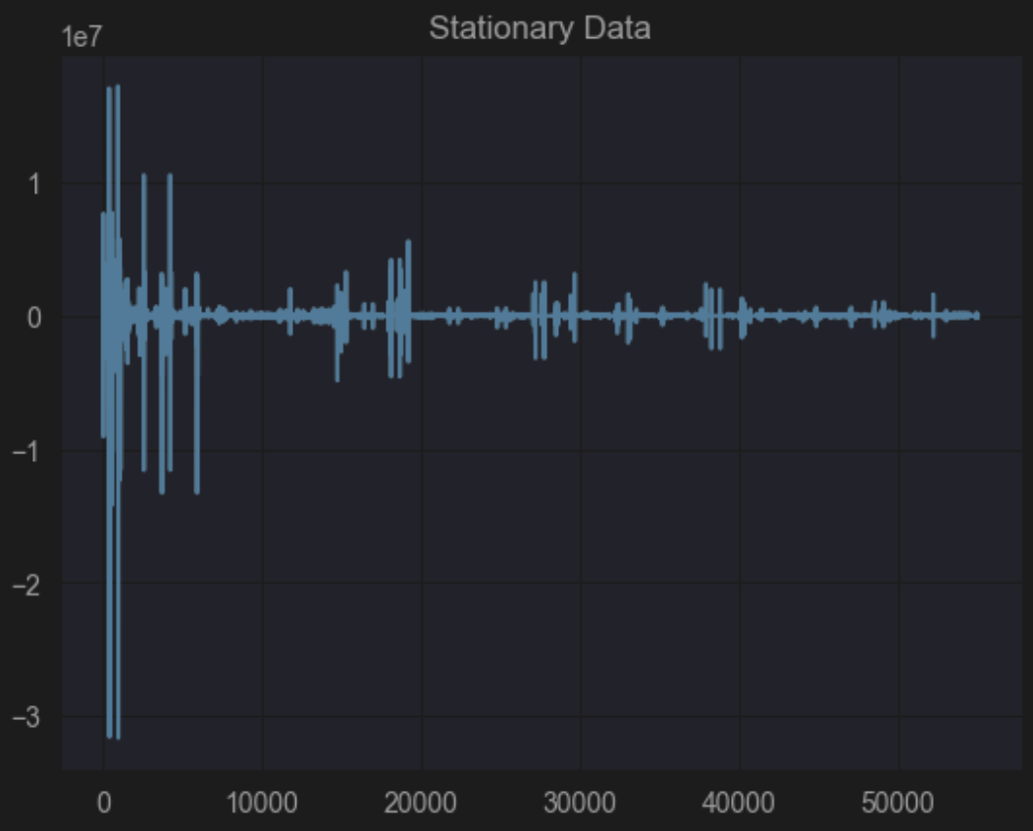
feature_engineering_timeseries
group_3

Slide 17
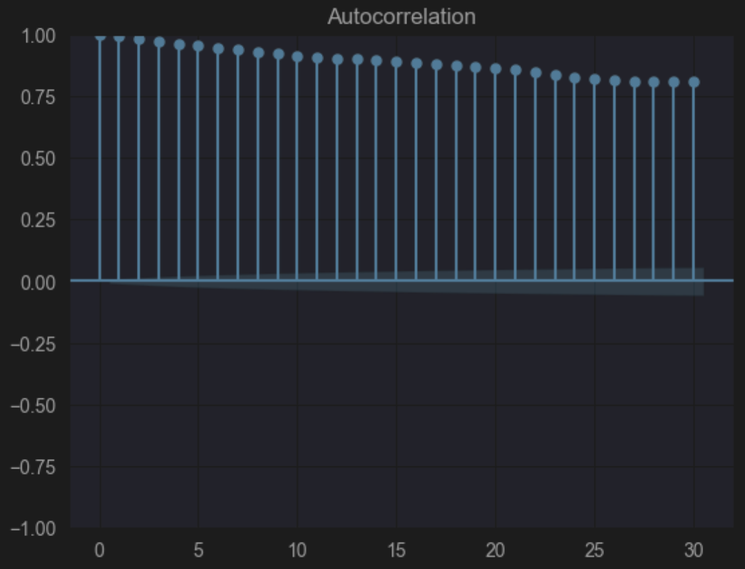
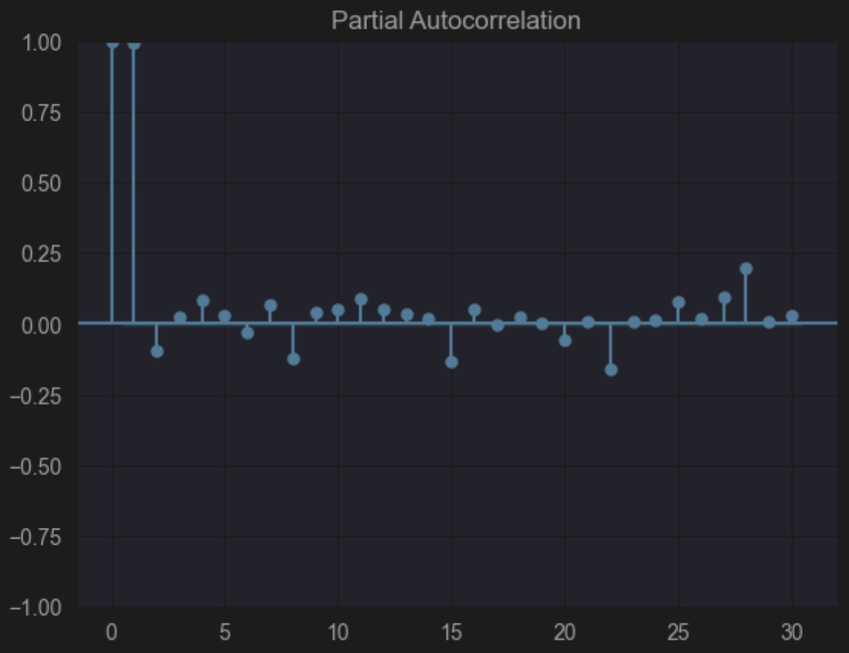
feature_engineering_timeseries
group_3

Slide 18
agenda = { }
(1: context_on_the_data),
(2: pre_processing),
(3: SQL_database),
(4: project_structure),
(5: feature_engineering_data_viz),
(6: feature_engineering_timeseries),
(7: random_forest)
group_3

Slide 19

random_forest
ScoreCard
Generated 7 lag features to capture temporal dependencies, utilizing the past week's data to forecast the next day's visits.
Handling Missing Values: Removed rows with missing lag feature values.
Model Selection: Chose RandomForestRegressor for its ability to handle nonlinear relationships and robustness against overfitting. Training and Testing: Split the data based on time, using the most recent 30 days as the test set to simulate real-world forecasting. Trained the model on historical data excluding the test period.
Evaluation: Evaluated model performance using Mean Absolute Error (MAE) and Root Mean Squared Error (RMSE) metrics. Emphasis on improving the accuracy with feature engineering and model tuning.
Key Takeaways: Leveraging temporal dependencies through lag features significantly helps when doing the time series forecasting.
RandomForestRegressor provides a solid baseline model with potential for further improvement and tuning.
Mean Absolute Error = 70471.32464941673
Root Mean Squared Error = 319719.3140311081
R-squared = 0.9887985057254655
Mean Absolute Percentage Error (MAPE) = inf%
group_3

Slide 20
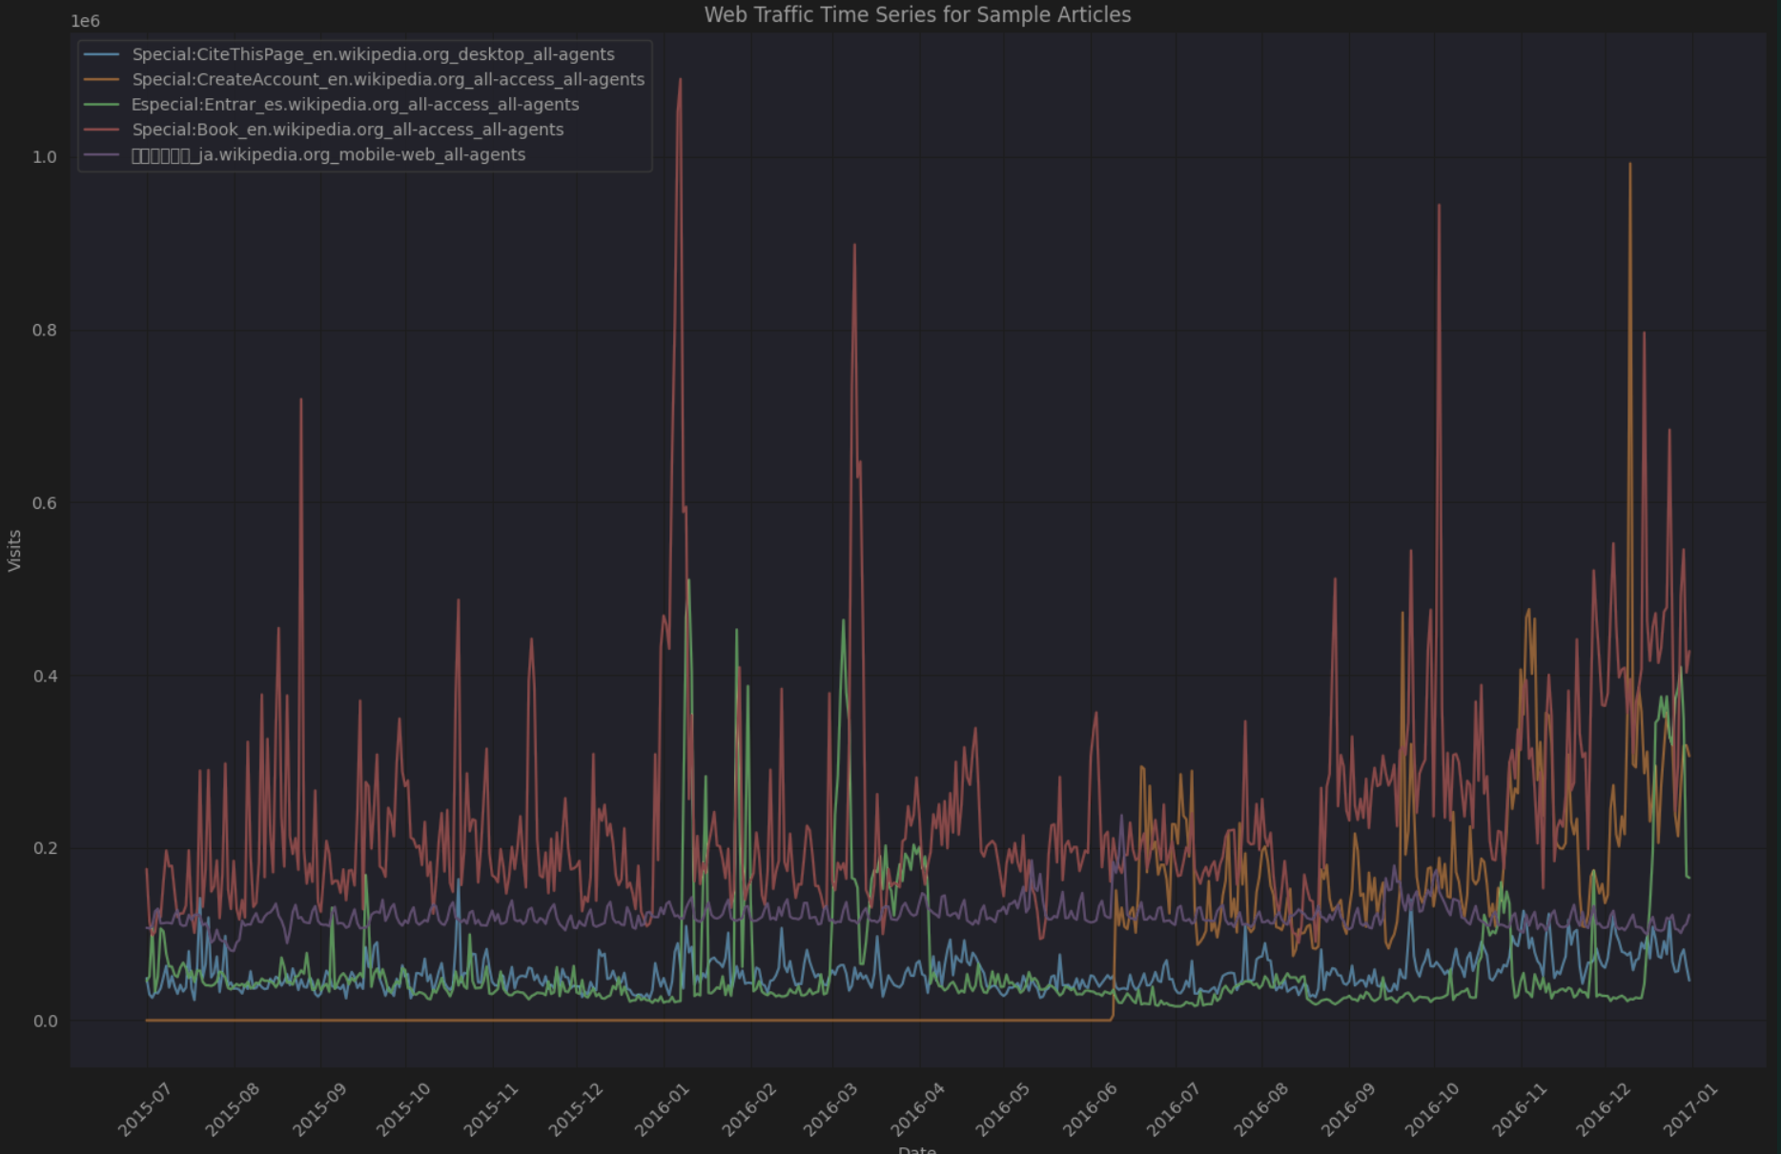
random_forest
group_3

Slide 21
<group3_section2> ‘‘wikipedia_timeseries_analysis’’
Executed succesfully
group_3

Slide 22
from section_2 import questions
questions = questions(wikipedia_group3)
print(questions)
group_3

